Slide 1
UNIT THREE
DATA REPRESENTATION IN COMPUTERS

Slide 2
Data Representation Method
Data representation refers to the methods used to represent information stored in a computer.
Computers stores many different types of information such as numbers, text, graphics of several varieties (still image, video, animation and sound)
All types of information are stored in a computer in the same simple format: 0’s and 1’s
How can 0’s and 1’s represent things as diverse as your photograph, your favorite song, a recent movie and your letter?
It all depends on how we interpret the information
Computers use numeric codes to represent all the information they store.
The codes used by computers are based on the binary number system instead of the more familiar decimal number system

Slide 3
UNITS OF DATA REPRESENTATION
When data is stored, processed or communicated within the computer system, it is packed in units.
Arranged from the smallest to the largest, the units are called bit, byte and word.
These units are based on the binary number system.
1. BIT
Bits are the smallest units and can convey only two possible states 0 or 1.
Bit stands for binary digits.
A bit is a single element in the computer, on a disk that stands for either “ON” indicating 1 or “OFF” indicating 0.
In computer “ON” is represented by the existence of current and “OFF” is represented by the non existence of current.
On a magnetic disk, the same information is stored by changing the polarity or magnetized particles on the disk’s surface.

Slide 4
2. BYTE
Bits can be organized into large units to make them represent more and meaningful information.
This large unit is called a byte and is the basic “unit of data representation” in a computer system.
The commonly used byte contains 8 bits.
Since each bit has two states and there are 8 bits in a byte, the total amount of data that can be represented is 2⁸ or 256 possible combinations.
Each byte can represent a character(a character is either a letter, a number or a special symbol such as +,-,?,*, $, etc).
A byte is then used as a unit of measurement in the computer memory, processing unit, external storage and during communication.
If the computer memory is 524288 byte, this is expressed in short by saying 512KB, where KB stands for kilobyte.
1 Kilobyte(1KB) is 2¹⁰ or 1024 bytes
1 Megabyte(MB) is 2²⁰ bytes or 2¹⁰ kilobytes
1 Gigabyte(GB) is 2³⁰ bytes or 2²⁰ kilobytes or 2¹⁰ megabytes

Slide 5
3. WORD
Word refers the number of bits that a computer process at a time or a transmission media transmits at a time.
Although bytes can store or transmit information, the process can even be faster if more than one byte is processed at a once.
A combination of bytes, then form a “word”.
A word can contain one, two, three or four bytes based on the capacity of the computer.
Word length is usually given in bits.
We say that a computer is an 8-bits, a 16 bit, a 32 bit or a 64 bit computer to indicate that the amount of data it can process at a time.
The large the word length a computer has the more powerful and faster it is.
A group of four bits is called a nibble (or nybble).
Bytes, therefore, consist of two nibbles: a “high-order nibble,” and a “low-order” nibble.

Slide 6
Number System
A number system is a set of symbols used for counting.
We have already seen that inside a computer system, data is stored in a format that can not be easily read by human beings.
This is the reason why input and output (I/O) interfaces are required.
Different characteristics that define a number system include the :
i) Number of independent digits used in the number system
ii) The place values of the different digits constituting the number and
iii) The maximum numbers that can be written with the given number of digits.
Among the three characteristic parameters, the most fundamental is the number of independent digits or symbols used in the number system.
It is known as the radix or base of the number system.
The decimal number system with which we are all so familiar can be said to have a radix of 10 as it has 10 independent digits, i.e. 0, 1, 2, 3, 4, 5, 6, 7, 8 and 9.

Slide 7
Similarly, the binary number system with only two independent digits, 0 and 1, is a radix-2 number system.
The octal and hexadecimal number systems have a radix (or base) of 8 and 16 respectively.
The place values of different digits:
For the integer part of the number are given by r⁰, r¹, r², r³ and so on, starting with the digit adjacent to the radix point.
For the fractional part, these are r⁻¹, r⁻², r⁻³ and so on, again starting with the digit next to the radix point.
Here, r is the radix of the number system.
Also, maximum numbers that can be written with n digits in a given number system are equal to r^{n}.

Slide 8
1. Decimal Number System
The decimal number system is a radix-10 number system and therefore has 10 different digits or symbols.
These are 0, 1, 2, 3, 4, 5, 6, 7, 8 and 9.
All higher numbers after ‘9’ are represented in terms of these 10 digits only.
The place values of different digits in a mixed decimal number:
Starting from the decimal point, are 10⁰, 10¹, 10² and so on (for the integer part) and 10⁻¹, 10⁻², 10⁻³ and so on (for the fractional part).
The value or magnitude of a given decimal number can be expressed as the sum of the various digits multiplied by their place values or weights.

Slide 9
As an illustration, in the case of the decimal number 3586.265:
The integer part (i.e. 3586) can be expressed as
3586 = 6×10⁰ +8×10¹+5×10² +3×10³ = 6+80+500+3000 = 3586
The fractional part(i.e, .256) can be expressed as
265 = 2×10⁻¹+6×10⁻² +5×10⁻³ = 0.2+0.06+0.005 = 0.265.
The place values are a function of the radix of the concerned number system and the position of the digits.
Each digit having a place value depending upon the position of the digit and the radix of the number system is equally valid for the other more relevant number systems.
Corresponding to the 1’s and 2’s complements in the binary system, in the decimal number system we have the 9’s and 10’s complements.

Slide 10
The 9’s complement of a given decimal number is obtained by subtracting each digit from 9.
For example, the 9’s complement of (2496)₁₀ would be (7503)₁₀.
The 10’s complement is obtained by adding ‘1’ to the 9’s complement.
The 10’s complement of (2496)₁₀ is (7504)₁₀.

Slide 11
2. Binary Number System
The binary number system is a radix-2 number system with ‘0’ and ‘1’ as the two independent digits.
All larger binary numbers are represented in terms of ‘0’ and ‘1’.
The procedure for writing higher order binary numbers after ‘1’ is similar to the one explained in the case of the decimal number system.
For example, the first 16 numbers in the binary number system would be 0, 1, 10, 11, 100, 101, 110, 111, 1000, 1001, 1010, 1011, 1100, 1101, 1110 and 1111.
The next number after 1111 is 10000, which is the lowest binary number with five digits.
This also proves the point made earlier that a maximum of only 16 (= 2⁴ numbers could be written with four digits).

Slide 12
Why do we select the binary number system to deal with?
It is because data representation in computers is by either the presence or absence of electronic or magnetic signals in its circuitry or the media it uses.
That means an ON or OFF switch, a positive or negative voltage, north or south magnetization
We can associate the digits 0 and 1 with this situations, since it has only two digits.
Digits Status
1 ON
0 OFF
1 North
0 South
1 Positive
0 Negative
Anyway, the digits of binary number system are called bits. Bit is a compression of binary digits.

Slide 13
The place values of different digits in a mixed binary number are 2⁰, 2¹, 2² and so on (for the integer part) and 2⁻¹, 2⁻², 2⁻³ and so on (for the fractional part).
Example 1.1 Consider an arbitrary number system with the independent digits as 0, 1 and X.
What is the radix of this number system? List the first 10 numbers in this number system.
Solution
The radix of the proposed number system is 3.
The first 10 numbers in this number system would be 0, 1, X, 10, 11, 1X, X0, X1, XX and 100.

Slide 14
Advantages of Binary System
1. Logic operations are the backbone of any digital computer, although solving a problem on computer could involve an arithmetic operation too.
The introduction of the mathematics of logic by George Boole laid the foundation for the modern digital computer.
Reduced the mathematics of logic to a binary notation of ‘0’ and ‘1’.
Mathematics of logic (also known as Boolean algebra) had been reduced to a binary notation, the binary number system had a clear edge over other number systems for use in computer systems.
2. All kinds of data could be conveniently represented in terms of 0s and 1s.

Slide 15
3. Basic electronic devices used for hardware implementation could be conveniently and efficiently operated in two distinctly different modes.
4. Circuits required for performing arithmetic operations such as addition, subtraction, multiplication, division, etc., become a simple affair when the data involved are represented in the form of 0s and 1s.
The 1’s complement of a binary number is obtained by complementing all its bits, i.e. by replacing 0s with 1s and 1s with 0s.
For example, the 1’s complement of (10010110)₂ is (01101001)₂.
The 2’s complement of a binary number is obtained by adding ‘1’ to its 1’s complement.
The 2’s complement of (10010110)₂ is (01101010)₂.

Slide 16
3. Octal Number System
It is a radix of 8 and therefore has eight distinct digits.
The independent digits are 0, 1, 2, 3, 4, 5, 6 and 7.
The next 10 numbers that follow ‘7’, for example, would be 10, 11, 12, 13, 14, 15, 16, 17, 20 and 21.
The place values for the different digits in the octal number system are:
8⁰, 8¹, 8² and so on (for the integer part) and
8⁻¹, 8⁻², 8⁻³ and so on (for the fractional part).
There are also 7’s and 8’s complements in octal number system:
The 7’s complement of a given octal number is obtained by subtracting each octal digit from 7.
For example, the 7’s complement of (562)₈ would be (215)₈.
The 8’s complement is obtained by adding ‘1’ to the 7’s complement.
The 8’s complement of (562)₈ would be (216)₈.

Slide 17
Why do we deal with the octal number system?
Every digit of the octal number system can be represented in binary number system using three(maximum) digits of the binary number system(0 and 1).
This makes the octal number system relatively easier to read and translate in to binary number system that the computer uses.
Continued-------------------from page 44 of the module

Slide 18
4. Hexadecimal Number System
it is a radix-16 number system and its 16 basic digits are 0, 1, 2, 3, 4, 5, 6, 7, 8, 9, A, B, C, D, E and F.
The place values or weights of different digits in a mixed hexadecimal number are:
16⁰, 16¹, 16² and so on (for the integer part) and
16⁻¹, 16⁻², 16⁻³ and so on (for the fractional part).
The decimal equivalent of A, B, C, D, E and F are 10, 11, 12, 13, 14 and 15 respectively, for obvious reasons.
The hexadecimal number system provides a condensed way of representing large binary numbers stored and processed inside the computer.
One such example is in representing addresses of different memory locations.

Slide 19
Let us assume that a machine has 64K of memory.
Such a memory has 64K (= 2¹⁶= 65 536) memory locations and needs 65 536 different addresses.
These addresses can be designated as 0 to 65 535 in the decimal number system and 00000000 00000000 to 11111111 11111111 in the binary number system.
The decimal number system is not used in computers and the binary notation here appears too cumbersome and inconvenient to handle.
But this inconvenient ways to represent data in a computer can be easily handled in hexadecimal number system, because:
65 536 different addresses can be expressed with four digits from 0000 to FFFF.
The hexadecimal number representation is convenient to handle the contents of the memory .

Slide 20
The 15’s and 16’s complements are defined with respect to the hexadecimal number system.
The 15’s complement is obtained by subtracting each hex digit from 15.
The 16’s complement is obtained by adding ‘1’ to the 15’s complement
For example:
The 15’s complement of (3BF)₁₆ would be (C40)₁₆.
The 16’s complement of (2AE)₁₆ would be (D52)₁₆.

Slide 21
Converting one Number System to the other
The decimal equivalent of a given number in another number system is given by the sum of all the digits multiplied by their respective place values.
The integer and fractional parts of the given number should be treated separately.
1. Binary-to-Decimal Conversion
The decimal equivalent of the binary number (1001.0101)₂ is determined as follows:
The integer part = 1001:
The decimal equivalent = 1 × 2⁰ + 0 × 2¹ + 0 × 2² + 1 × 2³ = 1 + 0 + 0 + 8 = 9
The fractional part = .0101
Therefore, the decimal equivalent = 0 × 2⁻¹ + 1 × 2⁻² + 0 × 2⁻³ + 1 × 2⁻⁴ = 0 + 0.25 + 0+ 0.0625 = 0.3125
Therefore, the decimal equivalent of (1001.0101)₂ = 9.3125

Slide 22
2. Octal-to-Decimal Conversion
The decimal equivalent of the octal number (137.21)₈ is determined as follows:
The decimal equivalent of the integer part, 137 = 7 × 8⁰ + 3 × 8¹ + 1 × 8² = 7 + 24 + 64 = 95
The decimal equivalent, the fractional part = .21 = 2 × 8⁻¹ + 1 × 8⁻² = 0.265
Therefore, the decimal equivalent of (137.21)₈= (95.265)₁₀
3. Hexadecimal-to-Decimal Conversion
The decimal equivalent of the hexadecimal number (1E0.2A)₁₆ is determined as follows:
The decimal equivalent integer part = 1E0= 0 × 16⁰ + 14 × 16¹ + 1 × 16² = 0 + 224 + 256 = 480 .
The decimal equivalent of the fractional part = 2A = 2 × 16⁻¹ + 10 × 16⁻² = 0.164
Therefore, the decimal equivalent of (1E0.2A)₁₆= (480.164)₁₀

Slide 23
4. Decimal-to-Binary Conversion
The integer and fractional parts are worked on separately.
The binary equivalent of the integer part can be found by successively dividing the integer part of the number by 2 and recording the remainders until the quotient becomes ‘0’.
Then the remainders is arranged in the reverse order constitute the binary equivalent.
The binary equivalent of the fractional part is found by successively multiplying the fractional part of the decimal number by 2 and recording the carry until the result of multiplication is ‘0’.
Then the carry sequence written in forward order constitutes the binary equivalent of the fractional part of the decimal number.
What is the binary equivalent of the decimal number (13.375)₁₀.?
The binary equivalent of the integer part of (13)₁₀ is (1101)₂
The binary equivalent of the fractional part, .375 is:
0.375 × 2 = 0.75 with a carry of 0
0.75 × 2 = 0.5 with a carry of 1
0.5 × 2 = 0 with a carry of 1
The binary equivalent of (0.375)₁₀ = (.011)₂
Therefore, the binary equivalent of (13.375)₁₀ = (1101.011)₂

Slide 24
5. Decimal-to-Octal Conversion
The process of decimal-to-octal conversion is similar to that of decimal-to-binary conversion.
The progressive division in the case of the integer part and the progressive multiplication while working on the fractional part here are by ‘8’ which is the radix of the octal number system.
Again, the integer and fractional parts of the decimal number are treated separately.
The octal equivalent of the decimal number (73.75)₁₀ is as follows:
The octal equivalent of the integer part is (73)₁₀ = (111)₈
The octal equivalent of the fractional part = 0.75 is
0.75 × 8 = 0 with a carry of 6, so the octal equivalent of (0.75)10 = (.6)₈
Therefore, the octal equivalent of (73.75)₁₀= (111.6)₈

Slide 25
6. Decimal-to-Hexadecimal Conversion
The process of decimal-to-hexadecimal conversion is also similar that of decimal-to-binary conversion.
Since the hexadecimal number system has a base of 16, the progressive division and multiplication factor in this case is 16.
Let us determine the hexadecimal equivalent of (82.25)₁₀
The hexadecimal equivalent of (82)₁₀= (52)16
The hexadecimal equivalent of the fractional part, 0.25 is:
0.25 × 16 = 0 with a carry of 4
Therefore, the hexadecimal equivalent of (82.25)₁₀= (52.4)₁₆.

Slide 26
7. Octal–Binary and Binary–Octal Conversions
An octal number can be converted into its binary equivalent by replacing each octal digit with its three-bit binary equivalent.
We take the three-bit equivalent because, the base of the octal number system is 8 and it is the third power of the base of the binary number system, i.e. 2.
A binary number can be converted into an equivalent octal number by splitting the integer and fractional parts into groups of three bits, starting from the binary point on both sides.
The 0s can be added to complete the outside groups if needed.
Let us find the binary equivalent of (374.26)₈ and the octal equivalent of (1110100.0100111)₂

Slide 27
The given octal number = (374.26)₈
The binary equivalent of this octal number is:
(011 111 100.010 110)₂ = (011111100.010110)₂
Any 0s on the extreme left of the integer part and extreme right of the fractional part of the equivalent binary number should be omitted.
Therefore, (011111100.010110)₂ = (11111100.01011)₂
The octal equivalent of the given binary number = (1110100.0100111)₂
(1110100.0100111)₂ = (1 110 100.010 011 1)₂= (001 110 100.010 011 100)₂= (164.234)₈

Slide 28
8. Hex–Binary and Binary–Hex Conversions
A hexadecimal number can be converted into its binary equivalent by replacing each hex digit with its four-bit binary equivalent.
We take the four-bit equivalent because the base of the hexadecimal number system is 16 and it is the fourth power of the base of the binary number system, 2.
A given binary number can be converted into an equivalent hexadecimal number by splitting the integer and fractional parts into groups of four bits, starting from the binary point on both sides.
The 0s can be added to complete the outside groups if needed.
Let us find the binary equivalent of (17E.F6)₁₆ and the hex equivalent of (1011001110.011011101)₂.

Slide 29
The binary equivalent of the given hex number = (17E.F6)₁₆ is :
(17E.F6)= (0001 0111 1110.1111 0110)₂
= (000101111110.11110110)₂= (101111110.1111011)₂
The 0s on the extreme left of the integer part and on the extreme right of the fractional part have been omitted.
The hexadecimal equivalent of the given binary number = (1011001110.011011101)₂ is:
= (10 1100 1110.0110 1110 1)₂
Therefore, hexadecimal equivalent of the = (0010 1100 1110.0110 1110 1000)₂ = (2CE.6E8)₁₆

Slide 30
9. Hex–Octal and Octal–Hex Conversions
For hexadecimal–octal conversion, the given hex number is firstly converted into its binary equivalent which is further converted into its octal equivalent.
An alternative approach is firstly to convert the given hexadecimal number into its decimal equivalent and then convert the decimal number into an equivalent octal number.
The former method is definitely more convenient and straightforward.
For octal–hexadecimal conversion:
The octal number may first be converted into an equivalent binary number
And then the binary number transformed into its hex equivalent.

Slide 31
The other option is firstly to convert the given octal number into its decimal equivalent and then convert the decimal number into its hex equivalent.
The former approach is definitely the preferred one.
Let us find the octal equivalent of (2F.C4)₁₆ and the hex equivalent of (762.013)₈
The binary equivalent of the given hex number (2F.C4)₁₆ is:
= (0010 1111.1100 0100)₂= (00101111.11000100)₂= (101111.110001)₂= (101 111.110 001)₂ = (57.61)₈.
The hex equivalent of the given octal number (762.013)₈ is:
= (111 110 010.000 001 011)₂= (111110010.000001011)₂= (0001 1111 0010.0000 0101 1000)₂= (1F2.058)₁₆.

Slide 32
Binary Arithmetic
Two types of operation that are performed on binary data include arithmetic and logic operations.
Basic arithmetic operations include addition, subtraction, multiplication and division.
AND, OR and NOT are the basic logic functions.
1. BINARY ADDITION
Adding binary numbers is a very simple task, and very similar to the longhand addition of decimal numbers.
As with decimal numbers, you start by adding the bits (digits) one column, or place weight, at a time, from right to left.
Carry- a digit (or bit) that is carried over to the next most significant bit during an N-bit addition operation
The carry bit is a 1 if the result was too large to be expressed in N bits. 0 + 0 = 0
1 + 0 = 1
0 + 1 = 1
1 + 1 = 10 ==========sum= 0 and carry =1
1 + 1 + 1 = 11 =======sum= 1 and carry=1

Slide 33
When the sum in one column is a two-bit (two-digit) number, the least significant figure is written as part of the total sum and the most significant figure is "carried" to the next left column.
Consider the following examples:
1001101 1001001 1000111
+ 0010010 +0011001 +0010110
------------ ----------- -----------
1011111 1100010 1011101
The addition problem on the left did not require any bits to be carried, since the sum of bits in each column was either 1 or 0, not 10 or 11.
In the other two problems, there definitely were bits to be carried, but the process of addition is still quite simple.

Slide 34
As we'll see later, there are ways that electronic circuits can be built to perform this very task of addition, by representing each bit of each binary number as a voltage signal (either "high," for a 1; or "low" for a 0).
This is the very foundation of all the arithmetic which modern digital computers perform.
2. BINARY SUBTRACTION
Subtraction is generally simpler than addition since only two numbers are involved and the upper value representation is greater than the lower value representation.
The problem of "borrow" is similar in binary subtraction to that in decimal.
We can construct a subtraction table that has two parts - the three cases of subtracting without borrow, and the one case of the involvement of a borrow digit, no matter how far to the left is the next available binary digit

Slide 35
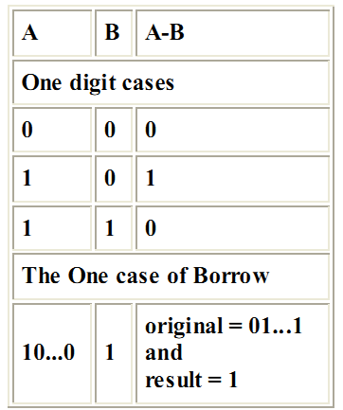
Binary Subtraction (example 1)
1110
-1001
?
110(10) Borrow Stage
- 100 1
010 1
(14 – 9 = 5)
Binary Subtraction (example 2)
10000
- 101
?
0111(10) Borrow ripples to LSB
- 10 1
101 1
(16 – 5 = 11)

Slide 36
3. BINARY MULTIPLICATION
It is actually much simpler than decimal multiplication.
In the case of decimal multiplication, we need to remember 3 x 9 = 27, 7 x 8 = 56, and so on.
In binary multiplication, we only need to remember the following,
0 x 0 = 0
0 x 1 = 0
1 x 0 = 0
1 x 1 = 1
Note that since binary operates in base 2, the multiplication rules we need to remember are those that involve 0 and 1 only.
As an example of binary multiplication we have 101 times 11,

Slide 37
101
x11
First we multiply 101 by 1, which produces 101.
Then we put a 0 as a placeholder as we would in decimal multiplication, and multiply 101 by 1, which produces 101.
101
x11
101
1010 <-- the 0 here is the placeholder
The next step, as with decimal multiplication, is to add.
The results from our previous step indicate that we must add 101 and 1010, the sum of which is 1111.
101
x11
101
1010
1111

Slide 38
4. BINARY DIVISION
Binary division is almost as easy, and involves our knowledge of binary multiplication.
It is the repeated process of subtraction, just as in decimal division.
Take for example the division of 1011 into 11.
11 R=10
11 )1011
-11
101
-11
10 <-- remainder, R
To check our answer, we first multiply our divisor 11 by our quotient 11.
Then we add its' product to the remainder 10, and compare it to our dividend of 1011.

Slide 39
Representation of Negative Numbers

Slide 40
An integer is a number with no fractional part; it can be positive, negative or zero.
A computer needs a way to represent negative numbers ( since there’s no “negative sign” in the comp).
To represent negative values, computer systems allocate the high-order bit to indicate the sign of a value.
The high-order bit is the leftmost bit in a byte. It’s also called the most significant bit.
The remaining bits contain the value of the number
The following are the common techniques used to represent negative numbers in a computer:
Sign-Bit Magnitude Method,
1’s Complement Method and
2’s Complement Method.

Slide 41
1.Sign-Bit Magnitude
In the sign-bit magnitude representation of negative decimal numbers:
The MSB represents the ‘sign’, with a ‘0’ denoting a plus sign and a ‘1’ denoting a minus sign.
The remaining bits represent the magnitude.
In eight-bit representation, while MSB represents the sign, the remaining seven bits represent the magnitude.
For example, the eight-bit representation of +9 would be 00001001, and that for −9 would be 10001001.
An n−bit binary representation can be used to represent decimal numbers in the range of −(2^{n−1}−1) to +(2^{n−1}−1).
That is, eight-bit representation can be used to represent decimal numbers in the range from −127 to +127 using the sign-bit magnitude format.

Slide 42
2. 1’s Complement
In the 1’s complement format, the positive numbers remain unchanged.
The negative numbers are obtained by taking the 1’s complement of the positive counterparts.
For example, +9 will be represented as 00001001 in eight-bit notation, and −9 will be represented as 11110110, which is the 1’s complement of 00001001.
Again, n-bit notation can be used to represent numbers in the range from −(2^{n−1}−1) to +(2^{n−1}−1) using the 1’s complement format.
The eight-bit representation of the 1’s complement format can be used to represent decimal numbers in the range from −127 to +127.

Slide 43
2’s Complement
In the 2’s complement representation of binary numbers:
The MSB represents the sign, with a ‘0’ used for a plus sign and a ‘1’ used for a minus sign.
The remaining bits are used for representing magnitude.
Positive magnitudes are represented in the same way as in the case of sign-bit or 1’s complement representation.
Negative magnitudes are represented by the 2’s complement of their positive counterparts.
For example, +9 would be represented as 00001001, and −9 would be written as 11110111.
Please note that, if the 2’s complement of the magnitude of +9 gives a magnitude of −9, then the reverse process will also be true, i.e. the 2’s complement of the magnitude of −9 will give a magnitude of +9.

Slide 44
The n-bit notation of the 2’s complement format can be used to represent all decimal numbers in the range from +(2^{n−1}−1) to −(2^{n−1}-1).
The 2’s complement format to represent a number is very popular as compared to the other format because:
It is very easy to generate the 2’s complement of a binary number and
Arithmetic operations are relatively easier to perform.

Slide 45
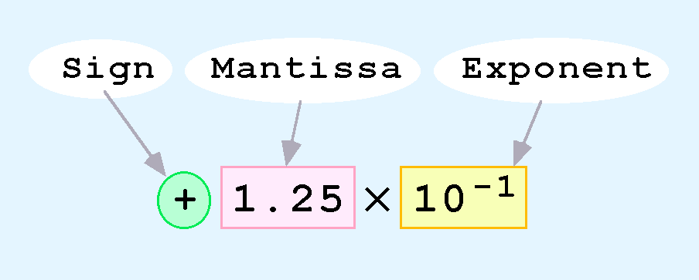
Floating Point Representation
The signed magnitude, 1’s complement, and 2’s complement representations as such are not useful in scientific or business applications that deal with real number values over a wide range.
Floating-point representation solves this problem.
Computers use a form of scientific notation for floating-point representation
Numbers written in scientific notation have three components:

Slide 46
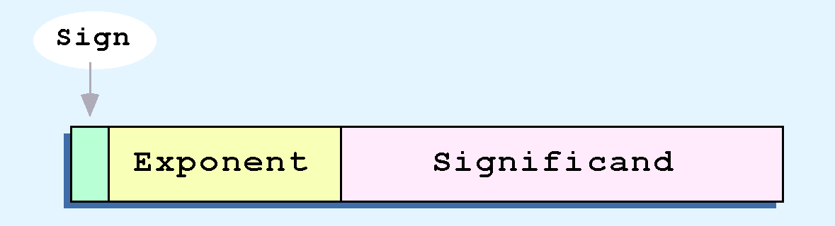
Computer representation of a floating-point number consists of three fixed-size fields:
This is the standard arrangement of these fields.
The one-bit sign field is the sign of the stored value.
The size of the exponent field, determines the range of values that can be represented.
The size of the significand determines the precision of the representation.

Slide 47
The IEEE-754 single precision floating point standard uses an 8-bit exponent and a 23-bit significand.
The IEEE-754 double precision standard uses an 11-bit exponent and a 52-bit significand.
For illustrative purposes, we will use a 14-bit model with a 5-bit exponent and an 8-bit significand.
The significand of a floating-point number is always preceded by an implied binary point.
Thus, the significand always contains a fractional binary value.
The exponent indicates the power of 2 to which the significand is raised.

Slide 48
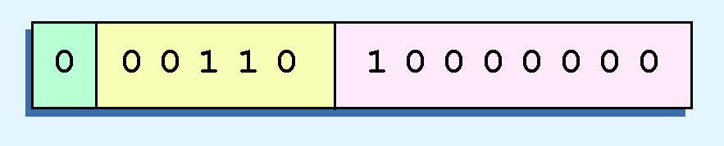
Example: Express 32₁₀ in the simplified 14-bit floating-point model.
We know that 32 is 2⁵. So in (binary) scientific notation 32 = 1.0 x 2⁵ = 0.1 x 2⁶.
Using this information, we put 110 (= 6₁₀) in the exponent field and 1 in the significand as shown.

Slide 49
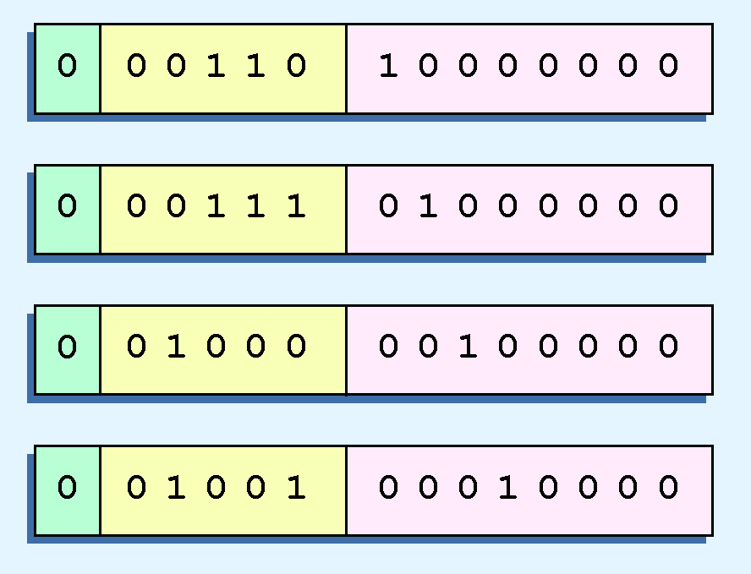
2.5 Floating-Point Representation
The illustrations shown at the right are all equivalent representations for 32 using our simplified model.
Not only do these synonymous representations waste space, but they can also cause confusion.

Slide 50
Another problem with our system is that we have made no allowances for negative exponents.
We have no way to express 0.5 (=2 ⁻¹)! (Notice that there is no sign in the exponent field!)
All of these problems can be fixed with no changes to our basic model.
To resolve the problem of synonymous forms, we will establish a rule that the first digit of the significand must be 1. This results in a unique pattern for each floating-point number.
In the IEEE-754 standard, this 1 is implied meaning that a 1 is assumed after the binary point.
By using an implied 1, we increase the precision of the representation by a power of two. (Why?)
In our simple instructional model, we will use no implied bits.

Slide 51
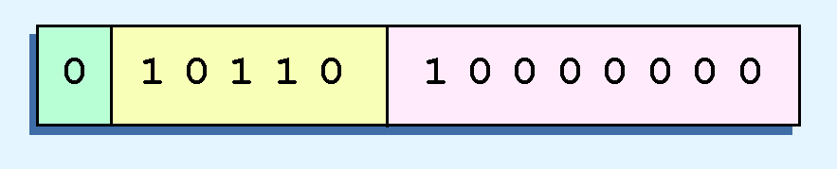
To provide for negative exponents, we will use a biased exponent.
A bias is a number that is approximately midway in the range of values expressible by the exponent.
We subtract the bias from the value in the exponent to determine its true value.
In our case, we have a 5-bit exponent. We will use 16 for our bias. This is called excess-16 representation.
In our model, exponent values less than 16 are negative, representing fractional numbers.
Example: Express 32₁₀ in the revised 14-bit floating-point model.
We know that 32 = 1.0 x 2⁵ = 0.1 x 2⁶.
To use our excess 16 biased exponent, we add 16 to 6, giving 22₁₀ (=10110₂).
Graphically:

Slide 52


Example: Express 0.0625₁₀ in the revised 14-bit floating-point model.
We know that 0.0625 is 2⁻⁴. So in (binary) scientific notation 0.0625 = 1.0 x 2⁻⁴ = 0.1 x 2 ⁻³.
To use our excess 16 biased exponent, we add 16 to -3, giving 13₁₀ (=01101₂).
Example: Express -26.625₁₀ in the revised 14-bit floating-point model.
We find 26.625₁₀ = 11010.101₂. Normalizing, we have: 26.625₁₀ = 0.11010101 x 2 ⁵.
To use our excess 16 biased exponent, we add 16 to 5, giving 21₁₀ (=10101₂). We also need a 1 in the sign bit.

Slide 53
The IEEE-754 single precision floating point standard uses bias of 127 over its 8-bit exponent.
An exponent of 255 indicates a special value.
If the significand is zero, the value is ± infinity.
If the significand is nonzero, the value is NaN, “not a number,” often used to flag an error condition.
The double precision standard has a bias of 1023 over its 11-bit exponent.
The “special” exponent value for a double precision number is 2047, instead of the 255 used by the single precision standard.
Both the 14-bit model that we have presented and the IEEE-754 floating point standard allow two representations for zero.
Zero is indicated by all zeros in the exponent and the significand, but the sign bit can be either 0 or 1.
This is why programmers should avoid testing a floating-point value for equality to zero.
Negative zero does not equal positive zero.

Slide 54
Coding Methods
Numeric data is represented by the binary numbering system
But text-based data is represented by binary coding systems specifically developed for text-based data—namely, ASCII, EBCDIC, and Unicode.
These codes are used to represent all characters that can appear in text data—such as numbers, letters, and special characters and symbols like the dollar sign, comma, percent symbol and many mathematical characters
ASCII CODE
ASCII (American Standard Code for Information Interchange) is the coding system traditionally used with personal computers.
ASCII is a 7-digit (7-bit) code, although there are several different 8-bit extended versions of ASCII that contain additional symbols not included in the 7-bit ASCII code.

Slide 55
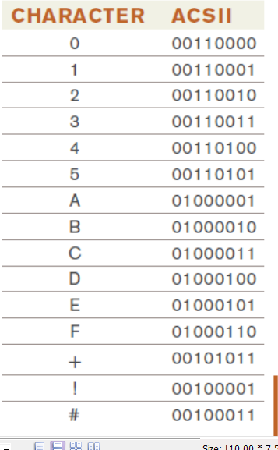

Slide 56
2. EBCDIC
EBCDIC(Extended Binary-Coded Decimal Interchange Code) was developed by IBM, primarily for use with mainframes.
EBCDIC represent each character as a unique combination of 8 bits.
One group of 8 bits (1 byte) allows 256 (28) unique combinations.
Therefore, an 8-bit code can represent up to 256 characters (twice as many as a 7-bit code) enough to include:
Characters used in the English alphabet, as well as some non-English characters,
The 10 decimal digits, the other characters usually found on a keyboard,
Many special characters not included on a keyboard such as mathematical symbols,
Graphic symbols, additional punctuation marks, and other symbols.

Slide 57
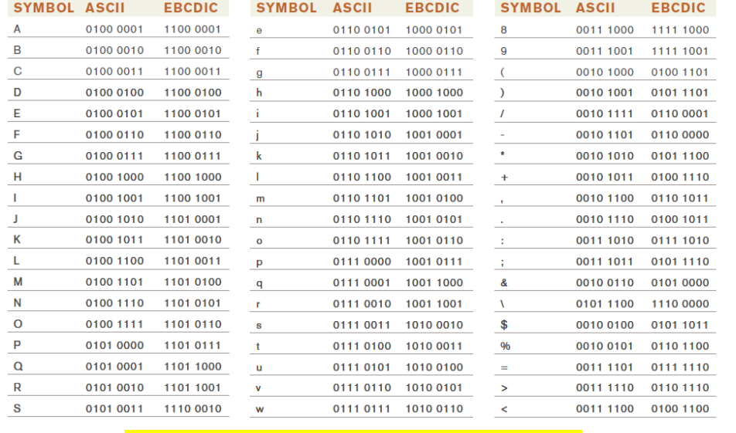
Fig: ASCII and EBCDIC binary codes for typical keyboard symbols.

Slide 58
3. Unicode
ASCII and EBCDIC, which are limited to only the Latin alphabet used with the English language.
Unicode is a universal international coding standard designed to represent text-based data written in any ancient or modern language, including those with different alphabets, such as Chinese, Greek, Arabic, Tibetan, and Russian.
Unicode uniquely identifies each character using 0s and 1s, no matter which language, program, or computer platform is being used.
It is a longer code, consisting of 1 to 4 bytes (8 to 32 bits) per character, and can represent over one million characters.
It is more than enough unique combinations to represent the standard characters in all the world’s written languages, as well as thousands of mathematical and technical symbols, punctuation marks, and other symbols and signs.
The biggest advantage of Unicode is that it can be used worldwide with consistent and unambiguous results.

Slide 59
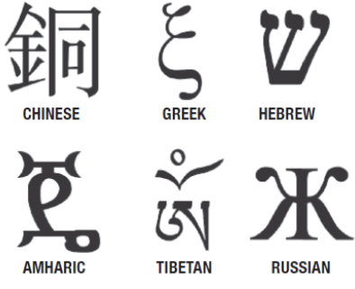
Unicode is quickly replacing ASCII as the primary text-coding system.
In fact, Unicode includes the ASCII character set so ASCII data can be converted easily to Unicode when needed.
Unicode is used by most Web browsers and is widely used for Web pages and Web applications (Google data, for instance, is stored exclusively in Unicode).
Most recent software programs, including the latest versions of Microsoft Windows, Mac OS, and Microsoft Office, also use Unicode, as do modern programming languages, such as Java and Python.
Unicode is updated regularly to add new characters and new languages not originally encoded—the most recent version is Unicode 5.2.

Slide 60
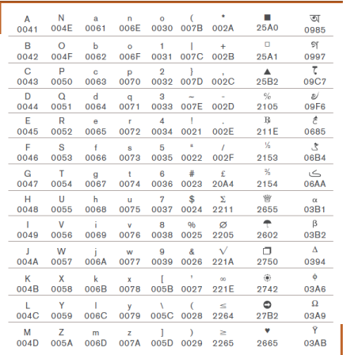
Fig: Selected Unicode codes

Slide 61
Computer System Architecture
Hierarchical structuring of a computer system Architecture
Actually a computer system composed of many layers of software and hardware.
But for simplicity we see the computer in Abstract way.
This avoids details and make the user to concern about the outer layer which is easy for the user to communicate with the computer.
Generally modern computers consists of multi-layers or levels.
The following figure shows the different levels.

Slide 62
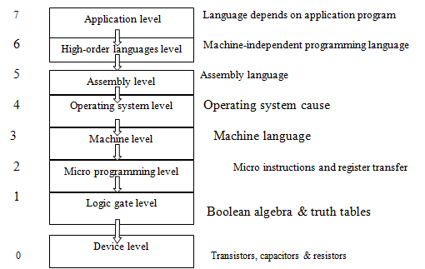
Fig: The level structure of a typical computer system

Slide 63
Programs written in there languages instruct the computer to perform certain operations.
A program to perform a specific task can be written at any one of the levels.
When computers were invented, only levels 1 and 3 were present.
Humans communicated with these machines by programming them in machine language at the machine level.
Machine language is great for machines but is tedious and inconvenient for a human programmer.
Therefor, level 4 is developed to manage the resource of the computer-Operating System Level.
A truth table shows the output of a logical function for all possible combinations of input values.

Slide 64
A gate is a mathematical abstraction of a physical device that we can boiled to perform the function of a truth table.
In the early days, every time a company introduced a new computer model, the programmers had to learn the assembly language for that model.
All their programs written for the old machine wouldn’t work on the new machine.
High order languages at level 6 were invented so programs could be transferred from one computer to another with little modification and because programming at a lower level.
Level 7, the application level allows to use the computer as a too without knowing the operational details at the lower levels.

Slide 65
Logical Elements and Boolean Algebra
In the hierarchical structuring of a computer the logic gate level is above the device level.
A gate is a circuit with one or more input signals but only one output signal.
Gates are digital ( two state) circuits because the input or output signals are either low or high voltages.
Gates are often called logic circuits because they can be analyzed with Boolean algebra.
Boolean algebra could be used to do manipulation with binary variables and simplify logic expressions.
These are actually implemented in a digital system with the help of electronic circuits called logic gates.
Boolean algebra deals with boolean (also called binary) values that are typically labeled true/false, 1/0, yes/no, on/off, and so forth.
Boolean Algebra: a useful mathematical system for specifying and transforming logic functions.

Slide 66
We study Boolean algebra as a foundation for designing and analyzing digital systems.
A Boolean function is a function that operates on binary inputs and returns binary outputs.
Computer hardware is based on the representation and manipulation of binary values.
Therefore, Boolean functions play a central role in the specification, construction, and optimization of hardware architectures.
Hence, the ability to formulate and analyze Boolean functions is the ﬁrst step toward constructing computer architectures.
There are three basic logic gates (logical operations), namely the OR gate, the AND gate and the NOT gate.
Other logic gates that are derived from these basic gates are the NAND gate, the NOR gate, the EXCLUSIVE-OR gate and the EXCLUSIVE-NOR gate.

Slide 67
1. OR Gate
An OR gate is a logic circuit with two or more inputs and one output.
The OR operation on two independent logic variables A and B is written as Y = A+B and reads as Y equals A OR B and not as A plus B.
The output of an OR gate is LOW(or 0) only when all of its inputs are LOW( or o).
For all other possible input combinations, the output is HIGH.
The operation of a two-input OR gate is explained by the logic expression Y = A+B (2.1)
If we have four logic variables and we want to know the logical output of (A+B+C +D), then it would be the output of a four-input OR gate with A, B, C and D as its inputs.

Slide 68
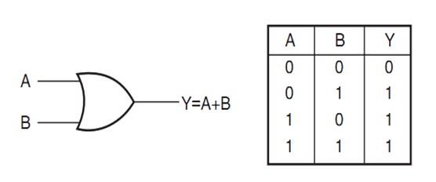
Figure 2.3: Two Input OR gate with its corresponding truth table

Slide 69
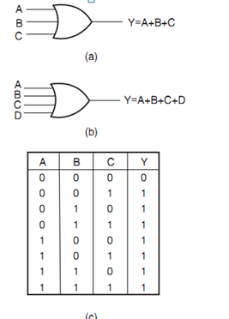
Figure 2.4 (a) Three input OR gate (b) Four-input OR gate and (c) Truth table of three-input OR gate

Slide 70
Figures 2.4(a) and (b) show the circuit symbol of three-input and four-input OR gates.
Figure 2.4(c) shows the truth table of a three-input OR gate.
Logic expressions explaining the functioning of three-input and four-input OR gates are Y=A+B+C and Y = A+B+C +D.
Activity 2.1 : 1. How would you hardware-implement a four-input OR gate using two-input OR gates only?
Solution
Figure 2.5(a) shows one possible arrangement of two-input OR gates that simulates a four-input OR gate.
A, B, C and D are logic inputs and Y3 is the output.
Figure 2.5(b) shows another possible arrangement.
In the case of Fig. 2.5(a), the output of OR gate 1 is Y 1=(A+B).

Slide 71
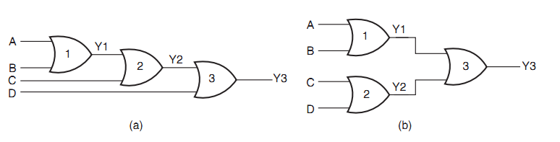
Figure 2.5 Activity 2.1.
The second OR gate produces the output Y2=Y1+C= A+B+C.
Similarly, the output of OR gate 3 is Y3=Y2+D= A+B+C+D.
In the case of Fig. 2.5(b), the output of OR gate 1 is Y1= A+B.
The second OR gate produces the output Y2 = C +D.
Output Y3 of the third OR gate is given by Y1+Y2 = A+B+C +D.

Slide 72
2. AND Gate
An AND gate is a logic circuit having two or more inputs and one output.
The output of an AND gate is HIGH only when all of its inputs are in the HIGH state. In all other cases, the output is LOW.
The logic symbol and truth table of a two-input AND gate are shown in Figs 2.6(a) and (b) respectively.
Figures 2.7(a) and (b) show the logic symbols of three-input and four-input AND gates respectively.
Figure 2.7(c) gives the truth table of a four-input AND gate.
The AND operation on two independent logic variables A and B is written as Y = A.B and reads as Y equals A AND B.
Here, A and B are input logic variables and Y is the output.

Slide 73
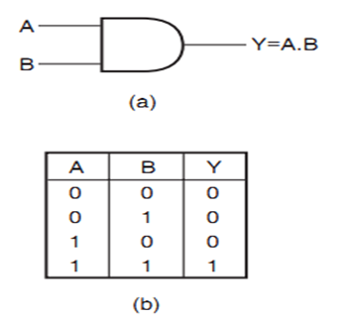
Figure 2.6 (a): Two-input AND gate and (b) Two-input truth table

Slide 74
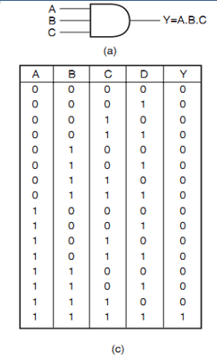
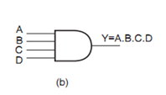
Figure 2.7(a) Three-input AND gate (b) Four-input AND gate and (c) Truth-table of four-input AND gate

Slide 75
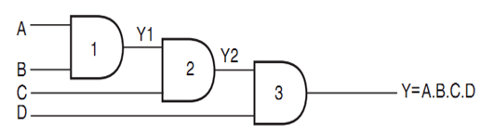
For a two-input AND gate, Y = A.B;
For a three-input AND gate, Y = A.B.C;
For a four-input AND gate, Y = ABCD.
Activity 2.2: 1. Show the logic arrangement for implementing a four-input AND gate using two-input AND gates only.
Solution
Figure 2.8 shows the hardware implementation of a four-input AND gate using two-input AND gates.
The output of AND gate 1 is Y1=A.B The second AND gate produces an output Y 2 given by Y 2 = Y 1.C = A.B.C.
Similarly, the output of AND gate 3 is Y= Y2.D = A.B.C.D and hence the result.
Figure 2.8: Implementation of a four-input AND gate using two-input AND gate

Slide 76
3. NOT Gate
A NOT gate is a one-input, one-output logic circuit.
The output of NOT gate is always the complement of the input.
That is, a LOW input produces a HIGH output, and vice versa.
It is also known as a ‘complementing circuit’ or an ‘inverting circuit’.
Figure 2.9 shows the circuit symbol and the truth table.
The NOT operation on a logic variable X is denoted as X or X.
That is, if X is the input to a NOT circuit, then its output Y is given by Y= X or X and reads as Y equals NOT X.
Thus, if X = 0, Y = 1 and if X = 1, Y = 0.

Slide 77
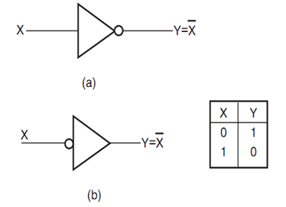
Figure 2.9(a): Circuit symbol of NOT gate and (b) Truth-table of NOT gate

Slide 78

4. EXCLUSIVE-OR Gate
The EXCLUSIVE-OR gate, commonly written as EX-OR gate, is a two-input, one-output gate.
The output of an EX-OR gate is a logic ‘1’ when the inputs are unlike and a logic ‘0’ when the inputs are like.
Although EX-OR gates are available in integrated circuit form only as two-input gates, unlike other gates which are available in multiple inputs also, multiple-input EX-OR logic functions can be implemented using more than one two-input gates.
The output of a multiple-input EX-OR logic function is a logic ‘1’ when the number of 1’s in the input sequence is odd and a logic ‘0’ when the number of 1’s in the input sequence is even, including zero.
That is, an all 0’s input sequence also produces a logic ‘0’ at the output.
The output of a two-input EX-OR gate is expressed by the following Boolean expression.

Slide 79
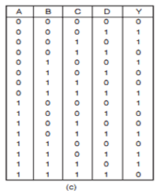
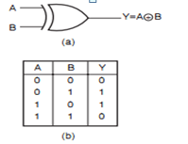
Figure 2.10(a) Circuit symbol of a two-input EXCLUSIVE-OR gate, (b) the truth table of a two-input EXCLUSIVE-OR gate and (c) the truth table of a four-input EXCLUSIVE-OR gate

Slide 80
Activity 2.3
3. How do you implement three-input and four-input EX-OR logic functions with the help of two-input EX-OR gates?
Solution
Figures 2.11(a) and (b) show the implementation of a three-input EX-OR logic function and a four-input EX-OR logic function using two-input logic gates:
For Fig. 2.11(a), the output Y1 is given by A ⊕ B.
The final output Y is given by Y = (Y1⊕)= (A⊕B)⊕C = A⊕B⊕C.
Figure 2.11(b) can be explained on similar lines.

Slide 81
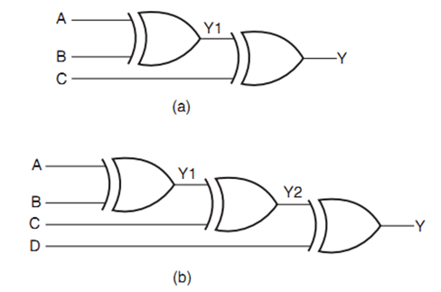
Figure 2.11 (a): Three-input EX-OR gate and (b) a four-input EX-OR gate

Slide 82

5. NAND Gate
NAND stands for NOT AND. An AND gate followed by a NOT circuit makes it a NAND gate, Fig. 2.13(a).
Figure 2.13(b) shows the circuit symbol of a two-input NAND gate.
The truth table of a NAND gate is obtained from the truth table of an AND gate by complementing the output entries, Fig.2.13(c).
The output of a NAND gate is a logic ‘0’ when all its inputs are a logic ‘1’.
For all other input combinations, the output is a logic ‘1’. NAND gate operation is logically expressed as
In general, the Boolean expression for a NAND gate with more than two inputs can be written as

Slide 83
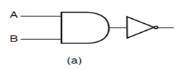
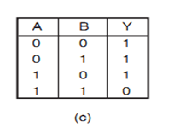
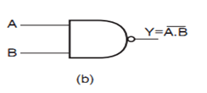
Figure 2.13 (a) Two-input NAND implementation using an AND gate and a NOT circuit, (b) the circuit symbol of a two-input NAND gate and (c) the truth table of a two-input NAND gate

Slide 84

6. NOR Gate
NOR stands for NOT OR.
An OR gate followed by a NOT circuit makes it a NOR gate [Fig. 2.14(a)].
The truth table of a NOR gate is obtained from the truth table of an OR gate by complementing the output entries.
The output of a NOR gate is a logic ‘1’ when all its inputs are logic ‘0’.
For all other input combinations, the output is a logic ‘0’.
The output of a two-input NOR gate is logically expressed as

Slide 85
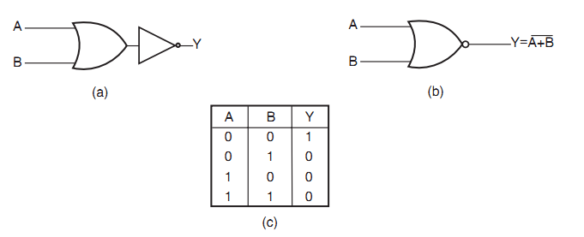

Figure 2.14 (a) Two-input NOR implementation using an OR gate and a NOT circuit, (b) the circuit symbol of a two-input NOR gate and (c) the truth table of a two-input NOR gate.
In general, the Boolean expression for a NOR gate with more than two inputs can be written as

Slide 86

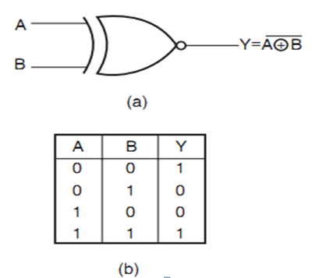
7. EXCLUSIVE-NOR Gate
EXCLUSIVE-NOR (commonly written as EX-NOR) means NOT of EX-OR, i.e. the logic gate that we get by complementing the output of an EX-OR gate.
Figure 2.15 shows its circuit symbol along with its truth table.
The truth table of an EX-NOR gate is obtained from the truth table of an EX-OR gate by complementing the output entries.
Logically,
Figure 2.15(a) Circuit symbol of a two-input EXCLUSIVE-NOR gate and (b) the truth table of a two-input EXCLUSIVE-NOR gate.

Slide 87
The output of a two-input EX-NOR gate is a logic ‘1’ when the inputs are like and a logic ‘0’ when they are unlike.
In general, the output of a multiple-input EX-NOR logic function is a logic ‘0’ when the number of 1s in the input sequence is odd and a logic ‘1’ when the number of 1s in the input sequence is even including zero.
That is, an all 0s input sequence also produces a logic ‘1’ at the output

Slide 88
Exercise
1. Show the logic arrangements for implementing:
(a) a four-input NAND gate using two-input AND gates and NOT gates;
(b) a three-input NAND gate using two-input NAND gates;
(c) a NOT circuit using a two-input NAND gate;
(d) a NOT circuit using a two-input NOR gate;
(e) a NOT circuit using a two-input EX-NOR gate
2. How do you implement a three-input EX-NOR function using only two-input EX-NOR gates?

Slide 89
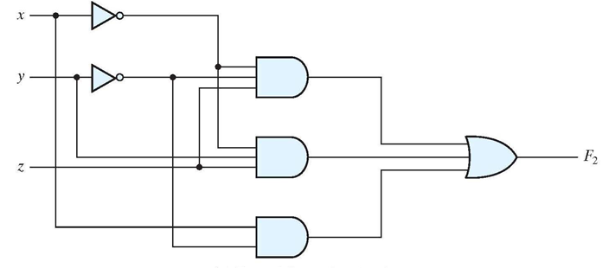
3. Transform the following logic circuit or diagram in to algebraic equation of F_{2?}

Slide 90
Reading Assignment
Adder (Half-adder and Full-adder)
Flip-flops

